Slide 1
Gender classification and age prediction
Jakkaphob Kongthanarith 6210554725

Slide 2
Literature review
Raphael Angulu , Jules R. Tapamo and Aderemi O. Adewumi “Age estimation via face images: a survey” , Angulu et al. EURASIP Journal on Image and Video Processing (2018)
S.A. Khan, Munir, Ahmad, Muhammad Nazir, N.Riaz “A comparative analysis of gender classification techniques” Middle East Journal of Scientific Research · January 2014
Kamekshi Gaur, Dr. Pawan Kumar “Literature Review on Gender Prediction Model using CNN Algorithm” , International Research Journal of Engineering and Technology (IRJET) Volume: 09 Issue: 03 | Mar 2022

Slide 3
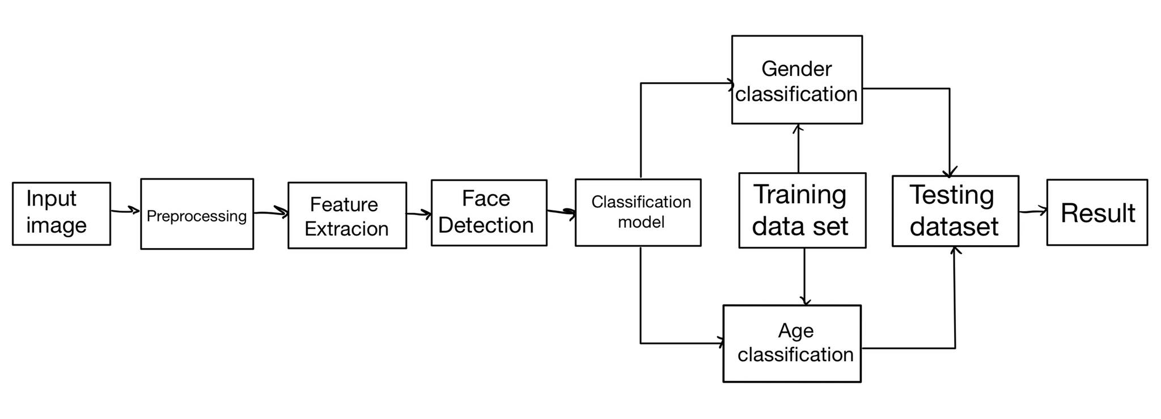
Block Diagram
Ref :Inspired by https://www.researchgate.net/publication/351635302_Deep_Learning_Based_Real_Age_and_Gender_Estimation_from_Unconstrained_Face_Image_towards_Smart_Store_Customer_Relationship_Management/download

Slide 4
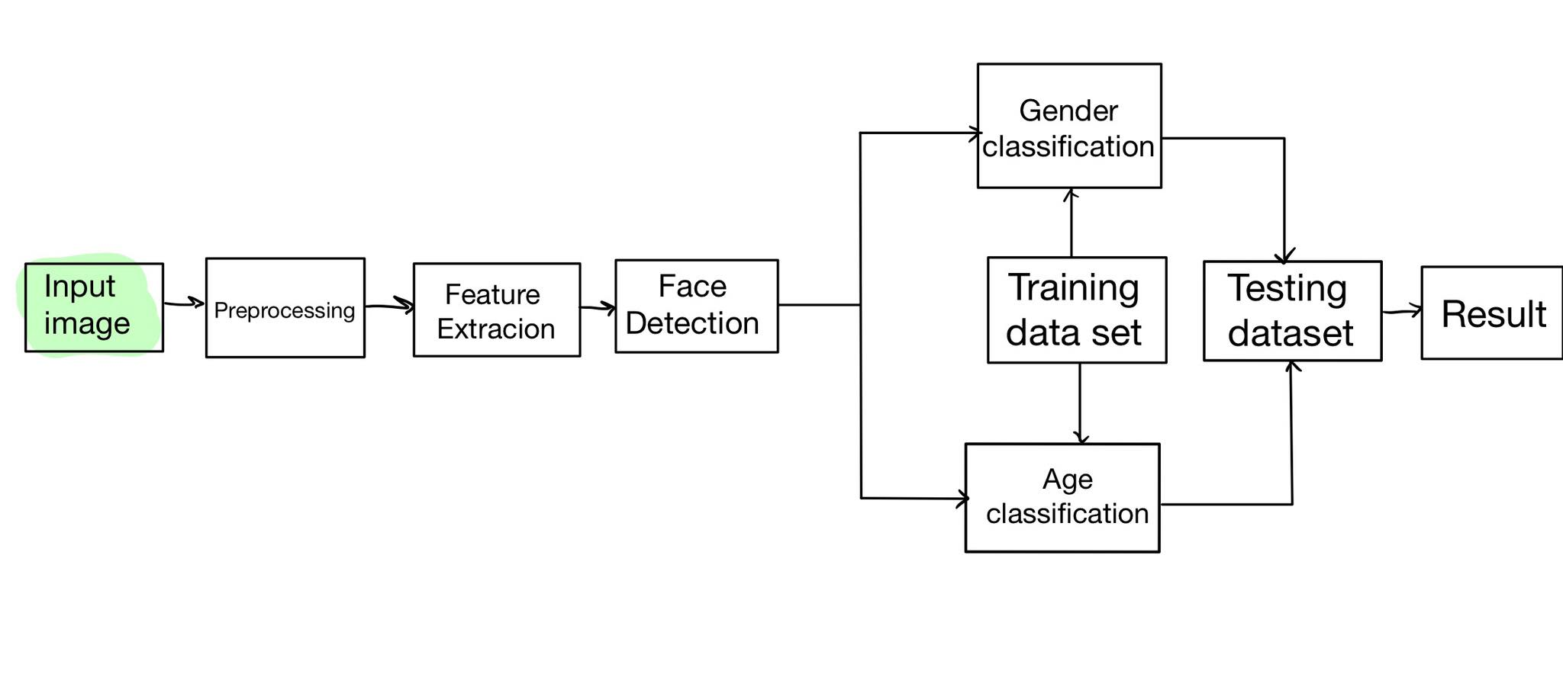
Input Image
The data set will contain an Image of Human, both man and woman from the various age. They will be contained in a different folder sort by their identity.
IMDb_crop : https://data.vision.ee.ethz.ch/cvl/rrothe/imdb-wiki/
CelebA : https://www.kaggle.com/datasets/jessicali9530/celeba-dataset

Slide 5
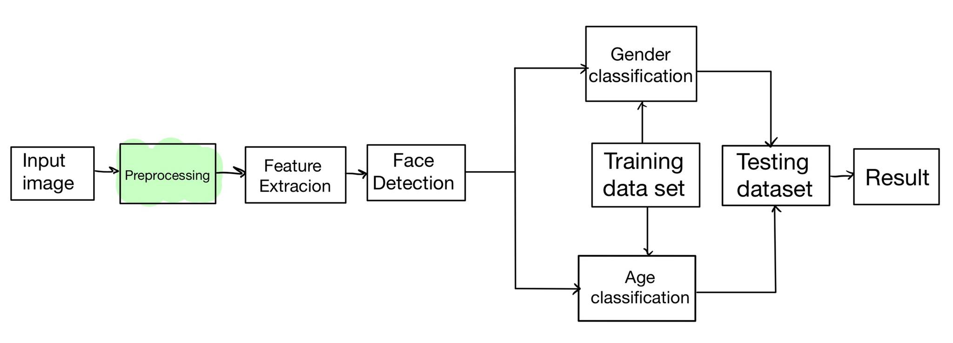
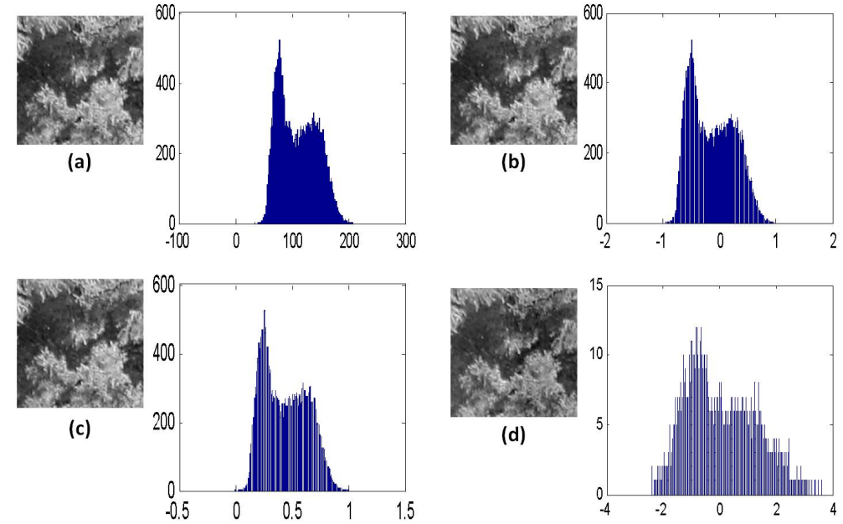
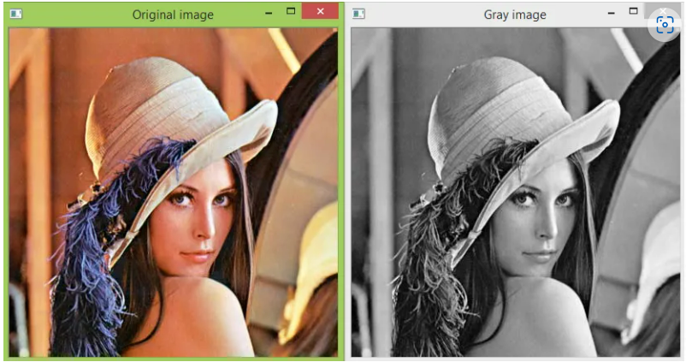
Image preprocessing
Gray scale conversion Image normalization
Gray scale conversion using opencv2
a. gray-scale version of original image b. min-max normalization [-1,+1]
c. min-max normalization [0,1] d. z-score normalization
Ref : https://techtutorialsx.com/2018/06/02/python-opencv-converting-an-image-to-gray-scale/
Ref :https://www.researchgate.net/figure/Examples-of-image-normalization-image-histogram-a-gray-scale-version-of-original_fig8_285458843

Slide 6
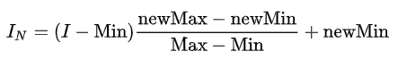
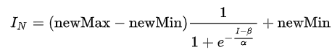
Image normalizatioN
Rescale input image’s pixel to a similar data distribution with each other. (changes the range of pixel intensity values.)
Linear Normalization
Nonlinear normalization
Ref:https://en.wikipedia.org/wiki/Normalization_(image_processing)#:~:text=In%20image%20processing%2C%20normalization%20is,contrast%20stretching%20or%20histogram%20stretching.

Slide 7
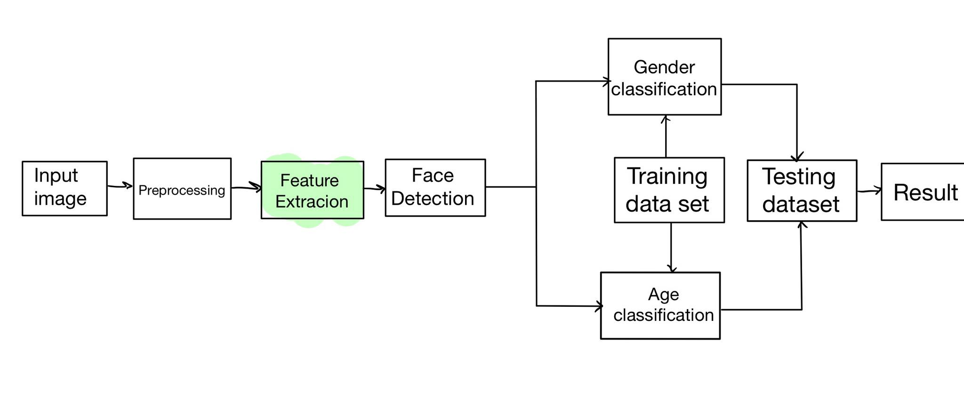
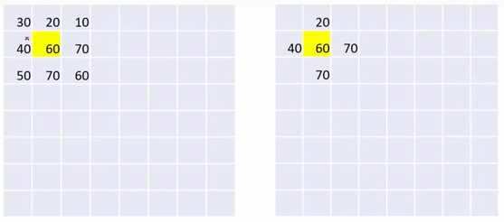
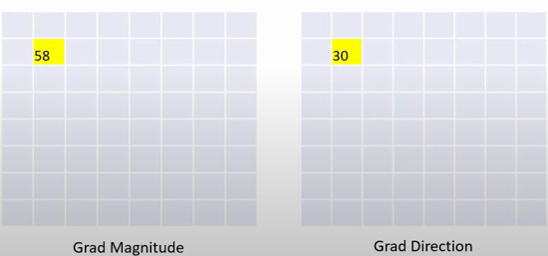
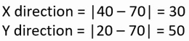
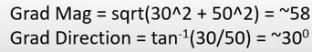
Feature extraction : Histogram oriented gradient (HOG)
Resize(or crop) the image into scale 2:1 or 1:2
Compute Gradient magnitude and Gradient direction and using both to compute histogram for getting a feature vector.
Ref : https://www.youtube.com/watch?v=28xk5i1_7Zc&t=318s

Slide 8
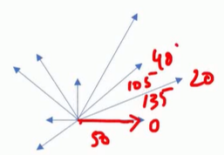
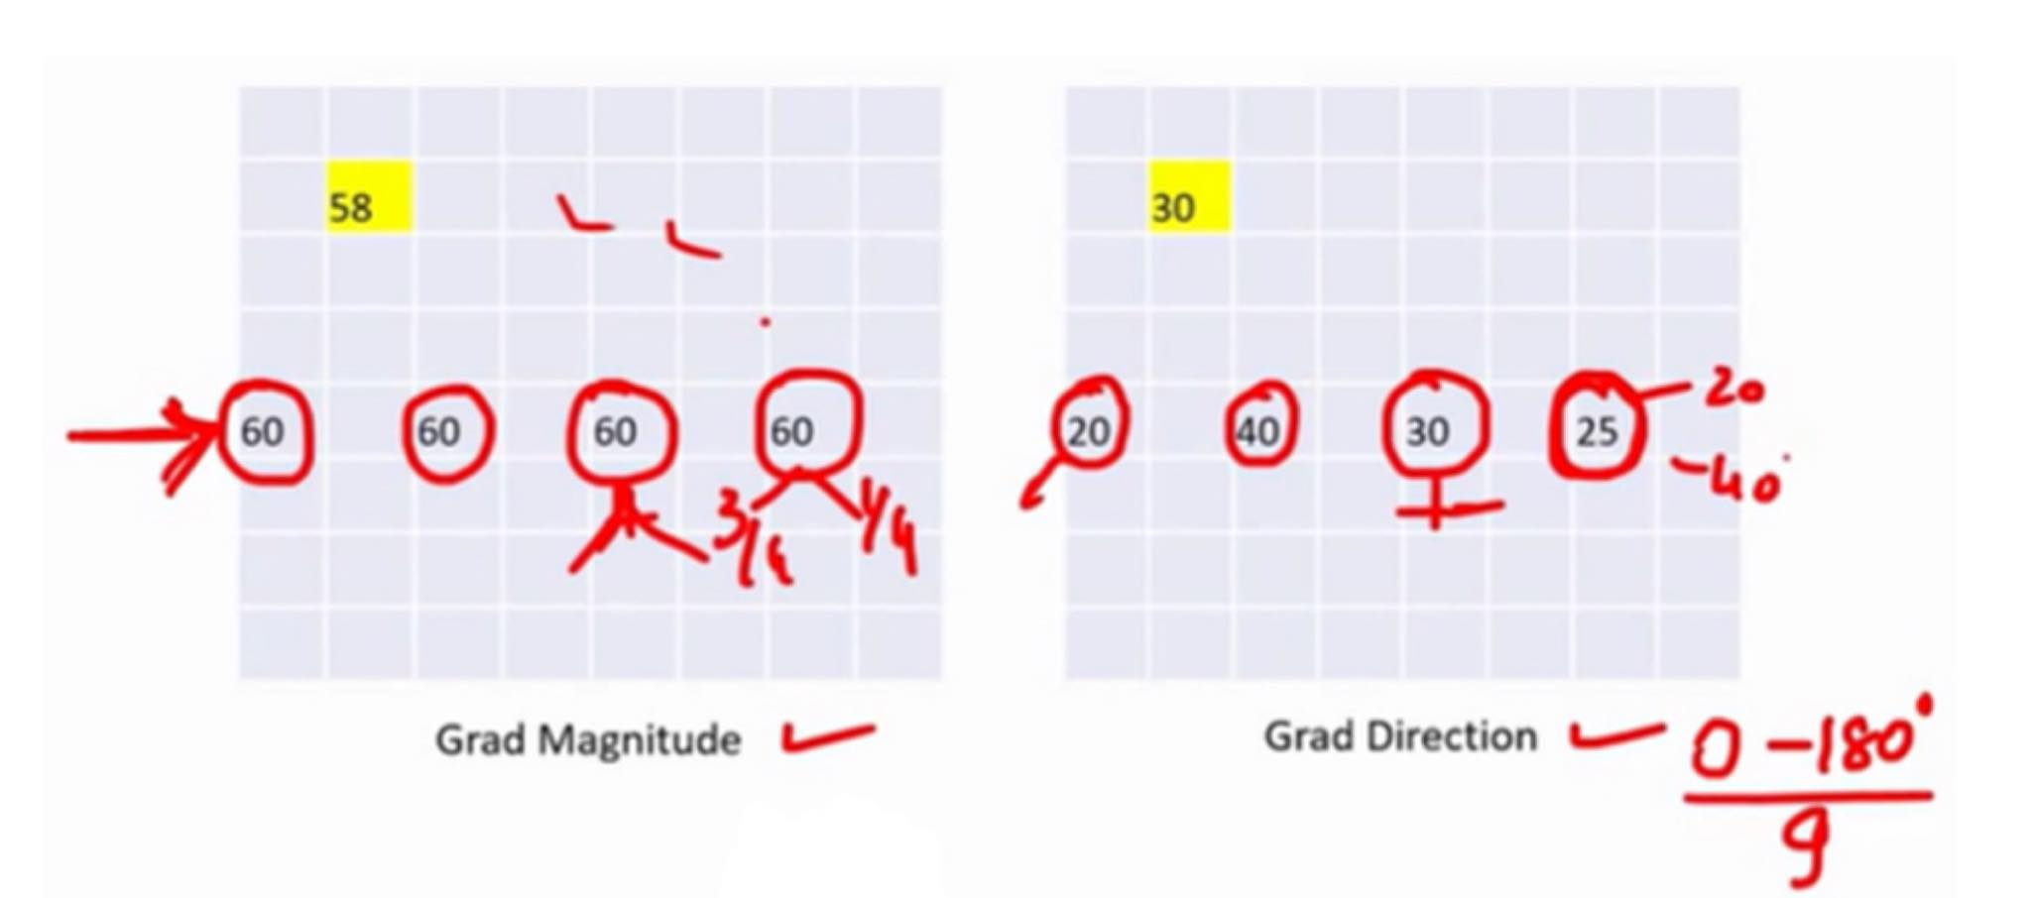
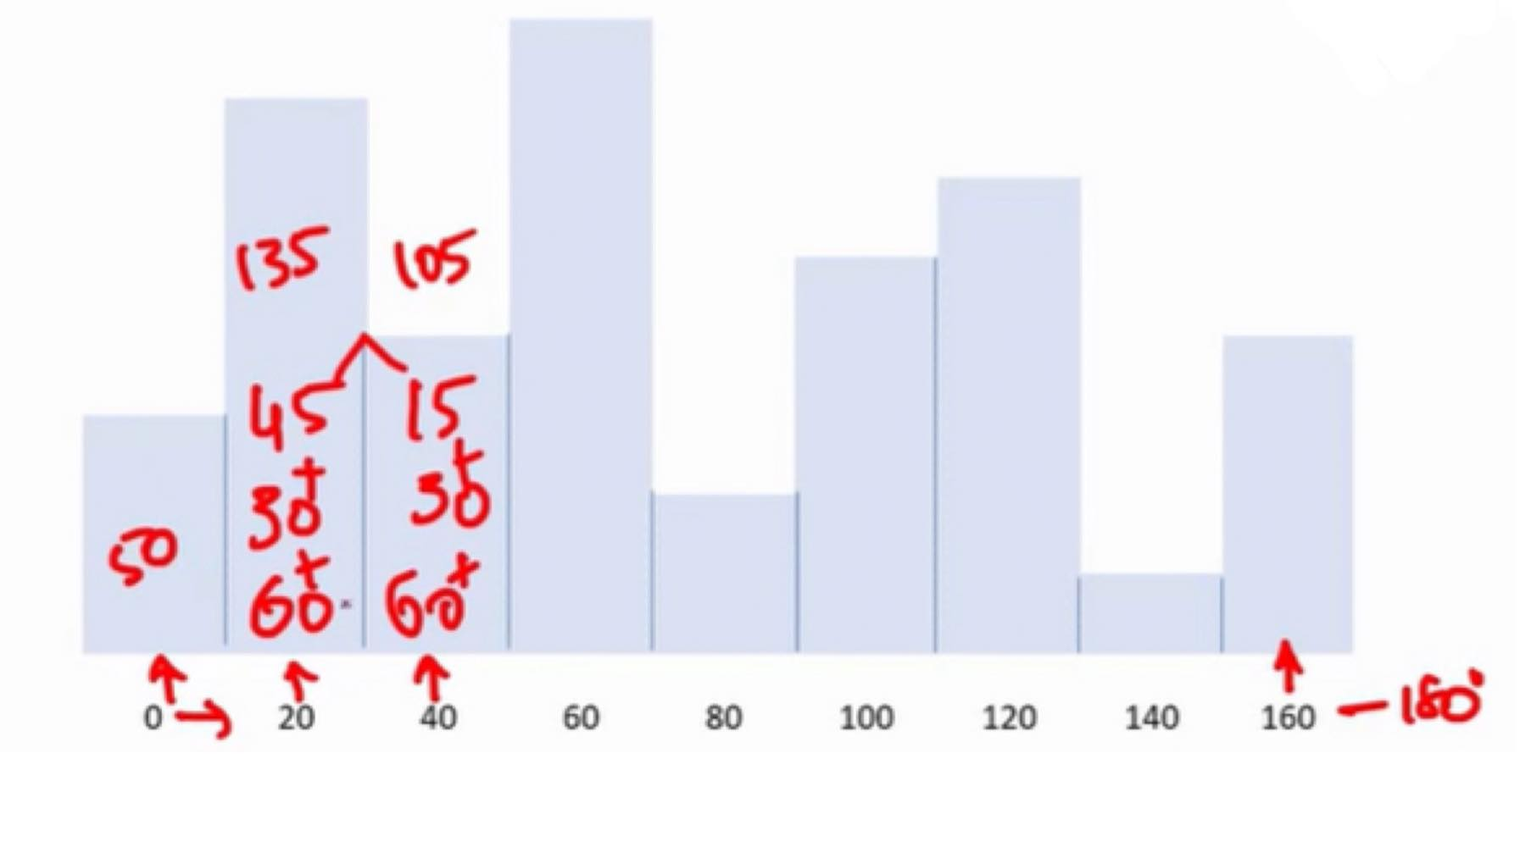
Feature vector
Divide each Cell into 9 bins according to the angle value (0-180).
Each Feature vector is pointed to [Direction] degree with [Magnitude] length
EX: 20 degree feature vector with the length of 135
Ref : https://www.youtube.com/watch?v=28xk5i1_7Zc&t=318s

Slide 9
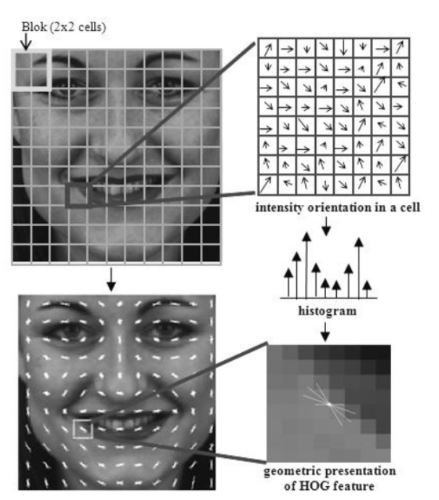
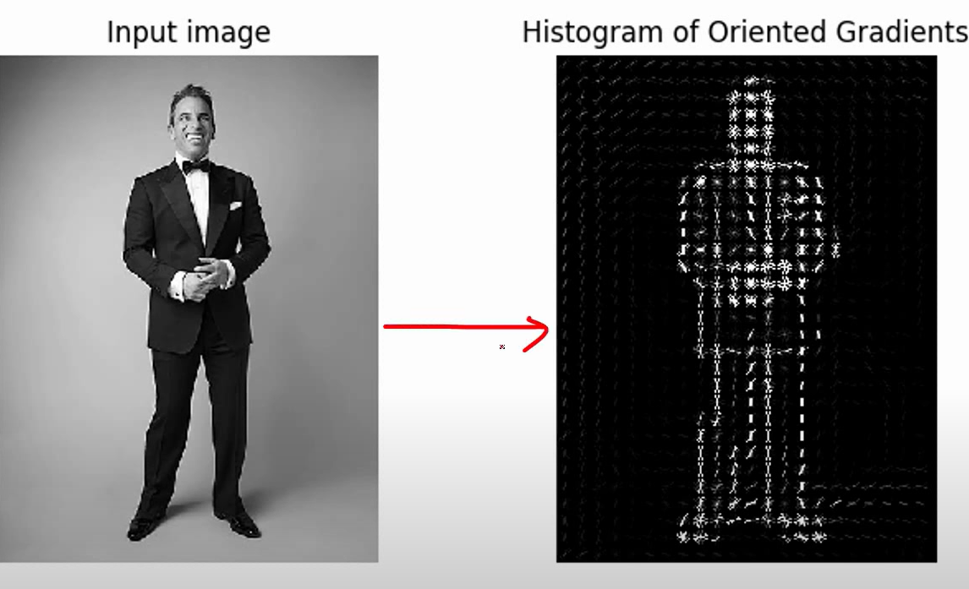
Each cell will be replaced with calculated feature vector. Making us able to extract a feature in the image. Then we will group each box(to combine ) a group of vector into one Geometric HOG feature
Ref:https://heartbeat.comet.ml/introduction-to-basic-object-detection-algorithms-b77295a95a63
Ref : https://www.youtube.com/watch?v=28xk5i1_7Zc&t=318s

Slide 10
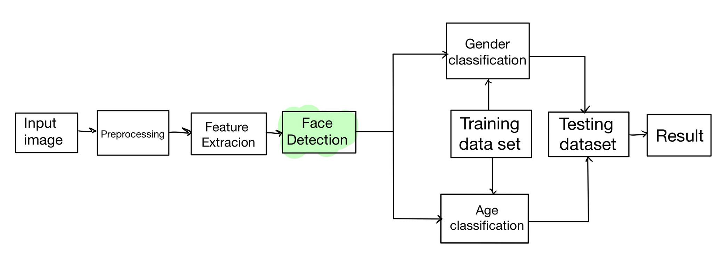
Face detection using Haar-cascade
The algorithm can be explained in four stages:
Calculating Haar Features
Creating Integral Images
Using Adaboost
Implementing Cascading Classifiers

Slide 11
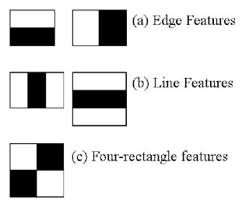
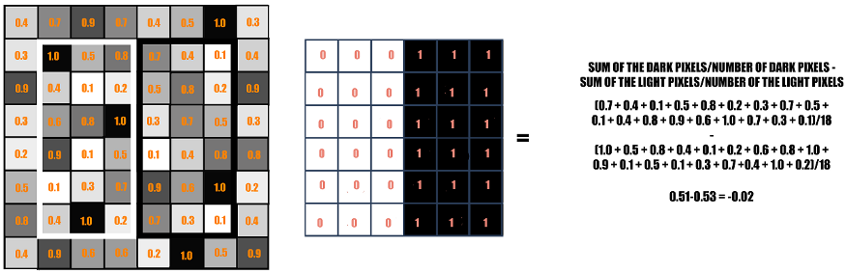
Calculating Haar Features
Identify faces in an image using 3 types of features
Ref:https://docs.opencv.org/3.4/db/d28/tutorial_cascade_classifier.html
Ref:http://www.tesrshop.com/article/12/cascade-training-with-haar-like-feature

Slide 12
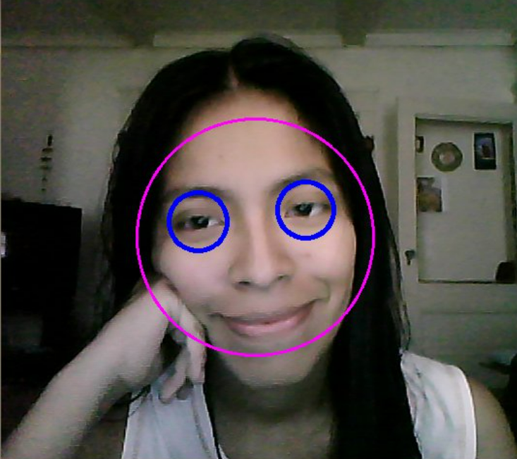
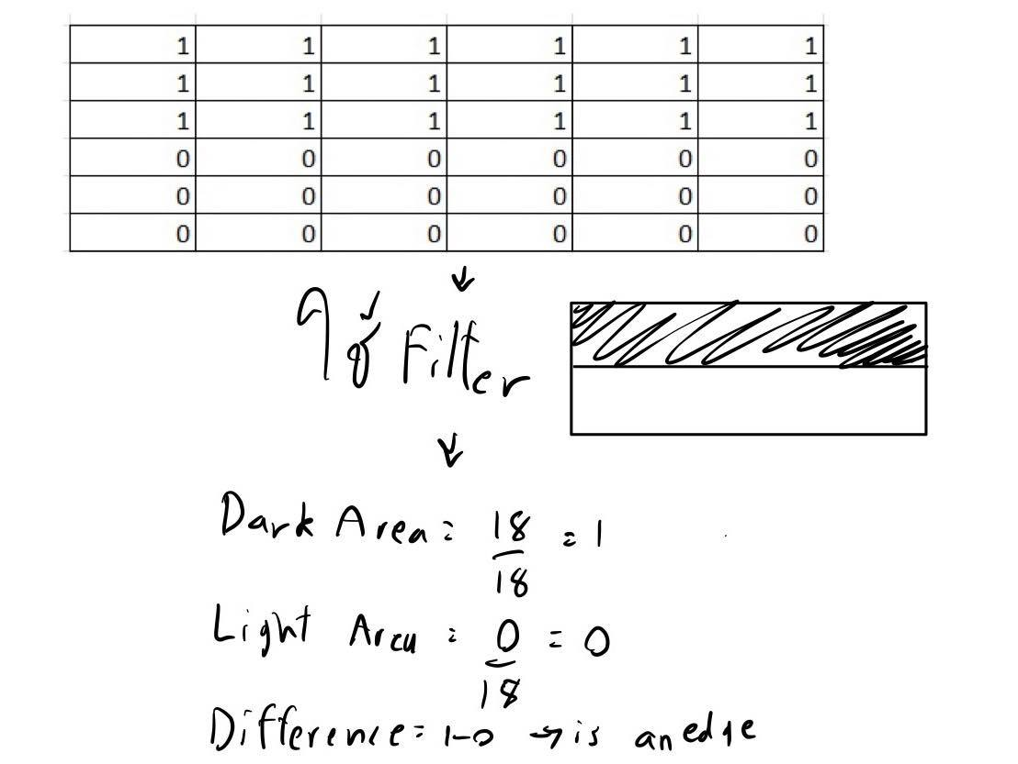
Comparing the output from the code with my hand-written calculation
The bottom are of the eye have white(1) pixel and an edge of black(0) pixel
The difference is 1, which told us haar-cascade can detect the area at the bottom of eye as an edge
Ref:https://docs.opencv.org/3.4/db/d28/tutorial_cascade_classifier.html

Slide 13
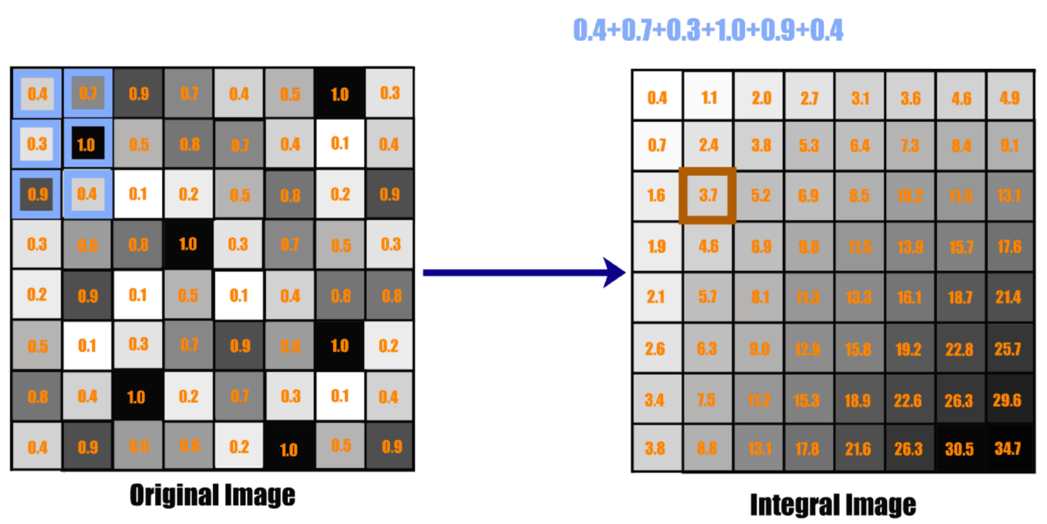
Creating Integral Images
Ref:http://www.tesrshop.com/article/12/cascade-training-with-haar-like-feature

Slide 14
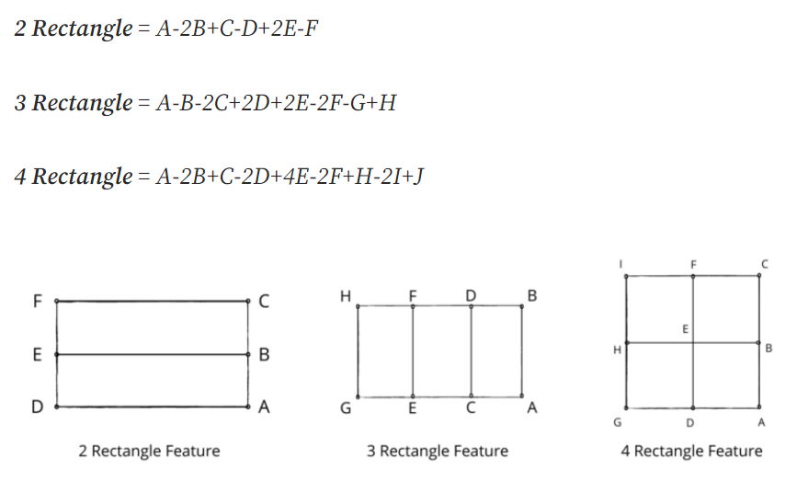
Formula for calculate Feature value with different kernel filter
Ref:https://towardsdatascience.com/viola-jones-algorithm-and-haar-cascade-classifier-ee3bfb19f7d8

Slide 15
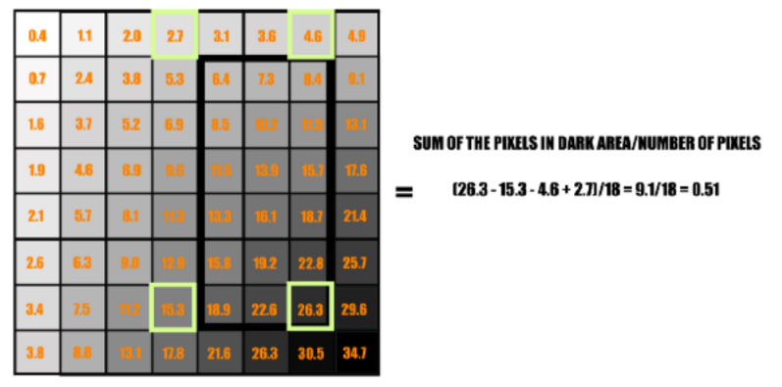
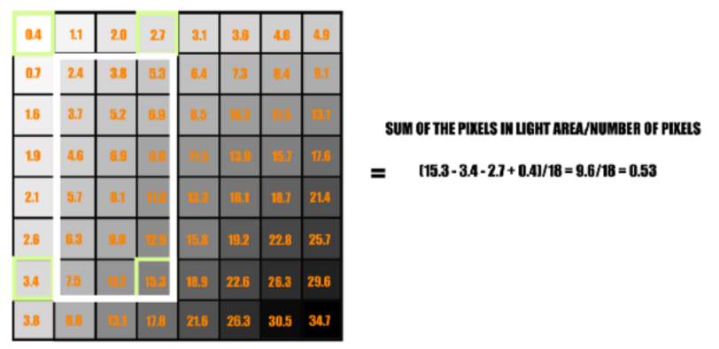
Calculate Feature value from integral image using edge feature
0.51-0.53 = -0.02 → is not an edge
Ref:http://www.tesrshop.com/article/12/cascade-training-with-haar-like-feature

Slide 16
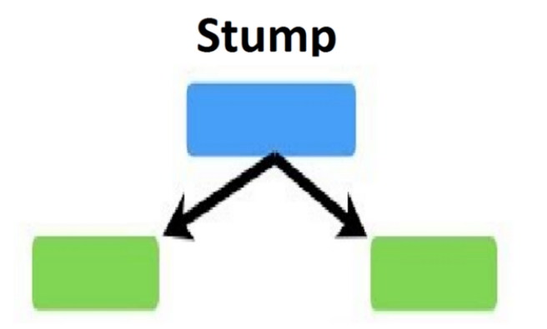
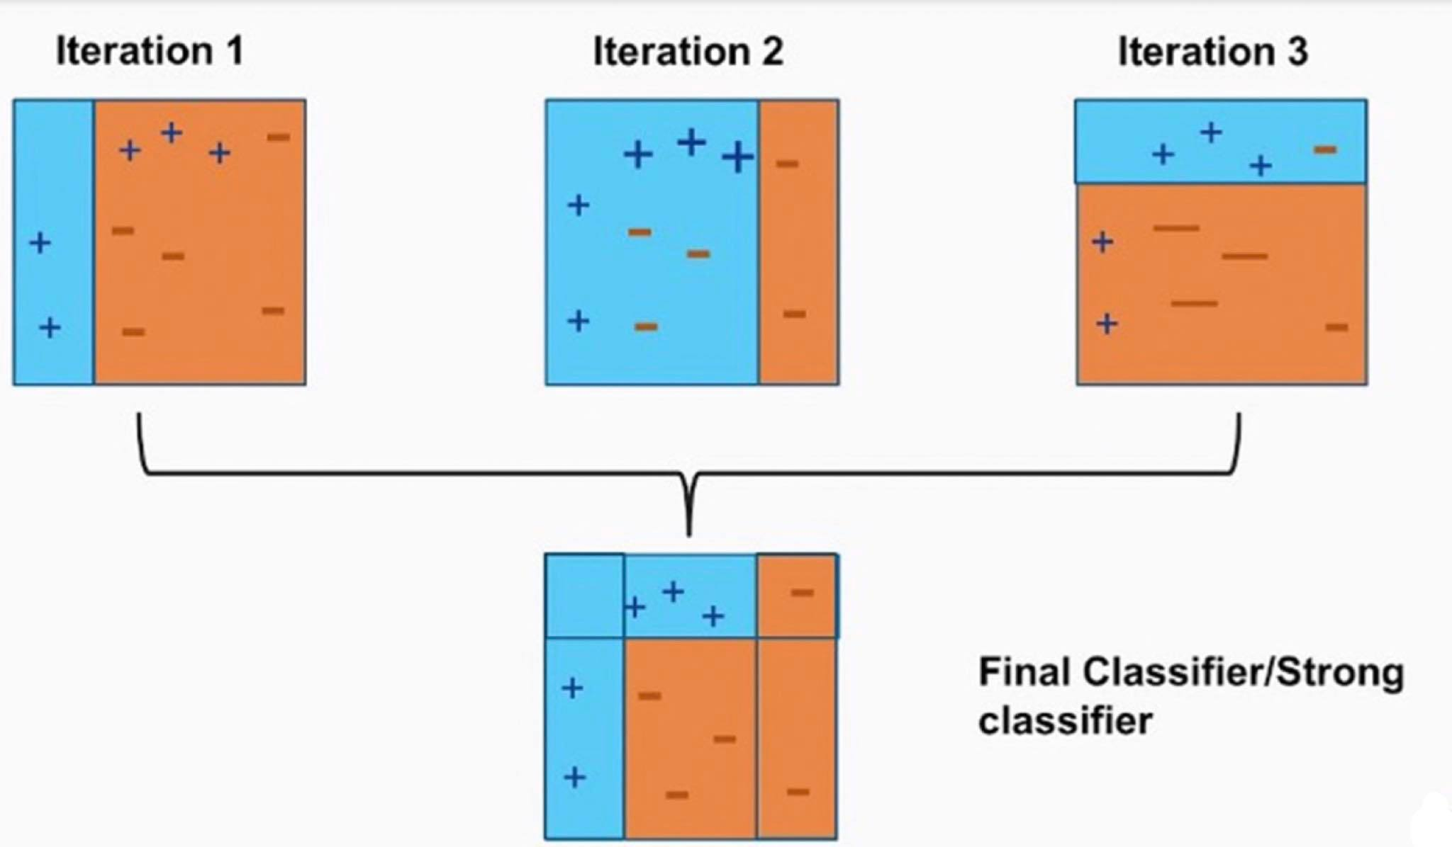
Using Adaboost
Creating a stump as a weak model.
When error occur, it will create another stump(model#2 to model#n depending on the result) and prioritize the error detection from previous stump. The process will stop when all group of data has been classified correctly.
Ref: https://medium.com/analytics-vidhya/diving-deeper-into-adaboost-92a9642e484f
Ref:https://www.youtube.com/watch?v=BoGNyWW9-mE

Slide 17
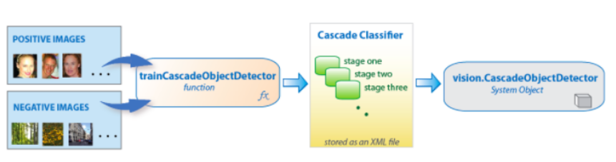
Implementing Cascading Classifiers
The cascade classifier is made up of a series of stages which created to reject negative sample. When the process start, The frame contained with a lot of kernel filter will start at the corner of the picture, it will scan for the indicated object, if the area filter was placed found an indicated object(positive), it will start a second stages. Different kernel features will be use on that area. The face will be redeemed as founded when all stages was return positive. If kernel filter cannot find the indicated object(negative) it will move to the next region
Ref:https://medium.com/analytics-vidhya/haar-cascades-explained-038210e57970d

Slide 18
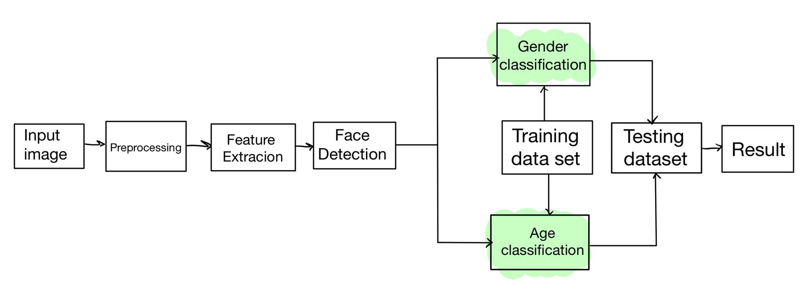
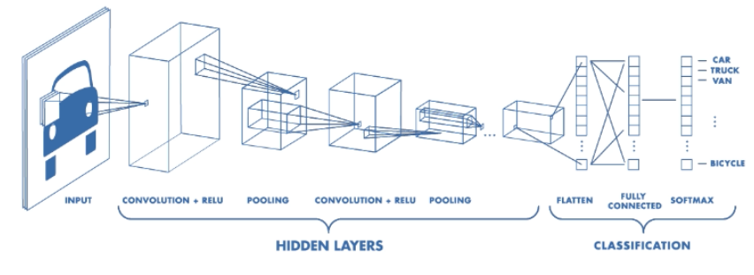
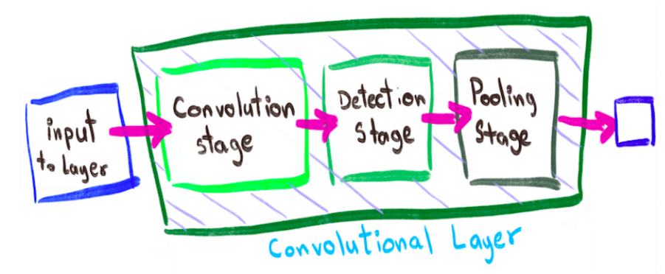
Convolutional Neural network (Age prediction and gender classification)
Inside Hidden layer

Slide 19
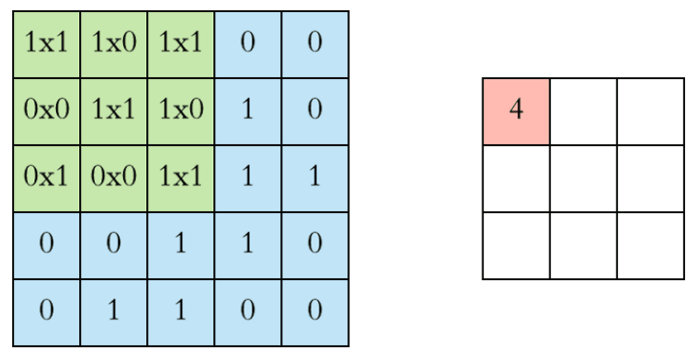
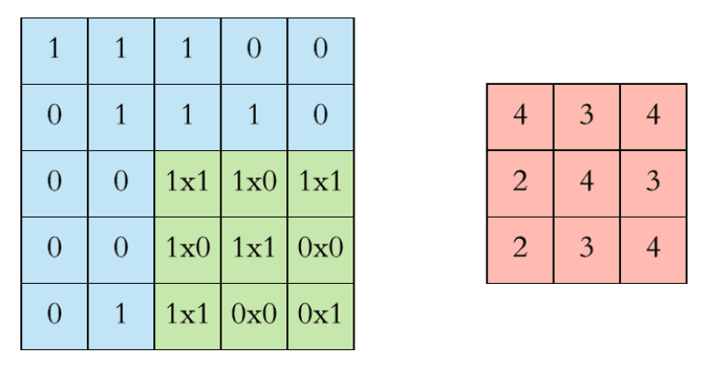
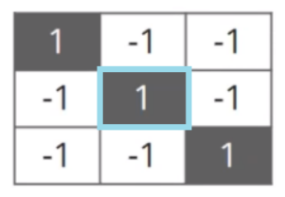
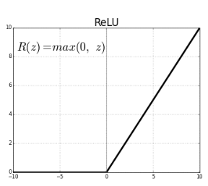
1. Convolution stage : Separate the structure of the picture using filter
3x3 filter for finding diagonal line
Start stop
2. Detector stage : Convert output from previous state in the form of nonlinear to create algorithm (ex: ReLu method. It can prevent Vanishing gradient, which decrease model train speed until zero) that will boost the speed of training model.
Ref:https://pasj.medium.com/%E0%B8%A2%E0%B8%B4%E0%B8%99%E0%B8%94%E0%B8%B5%E0%B8%97%E0%B8%B5%E0%B9%88%E0%B9%84%E0%B8%94%E0%B9%89%E0%B8%A3%E0%B8%B9%E0%B9%89%E0%B8%88%E0%B8%B1%E0%B8%81-cnn-convolutional-neural-network-816772eee18c
ReLu Ref: https://towardsdatascience.com/applied-deep-learning-part-4-convolutional-neural-networks-584bc134c1e2

Slide 20
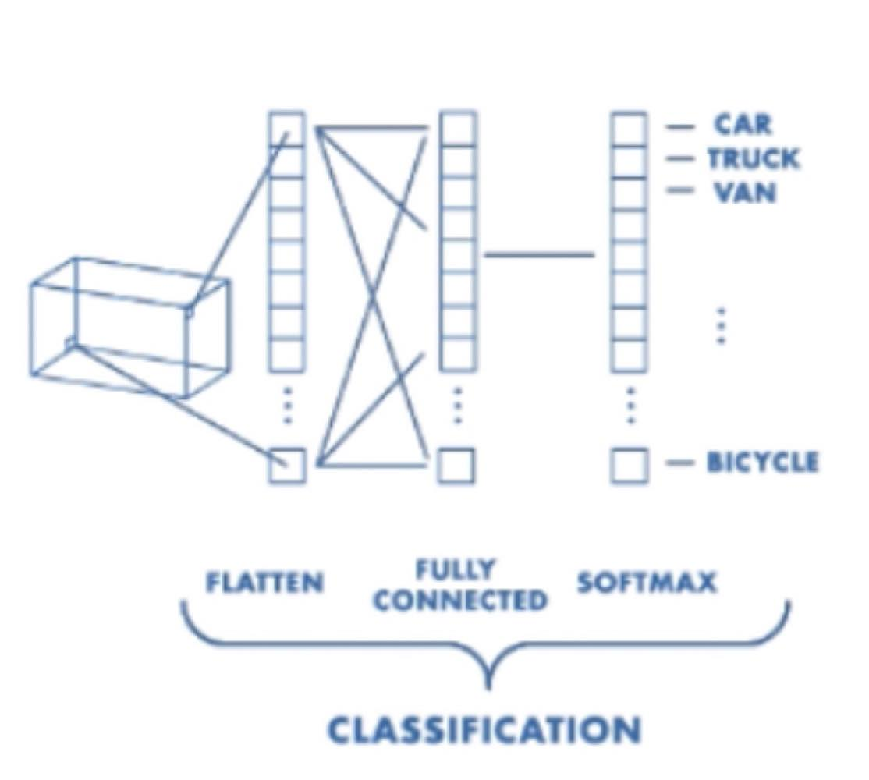
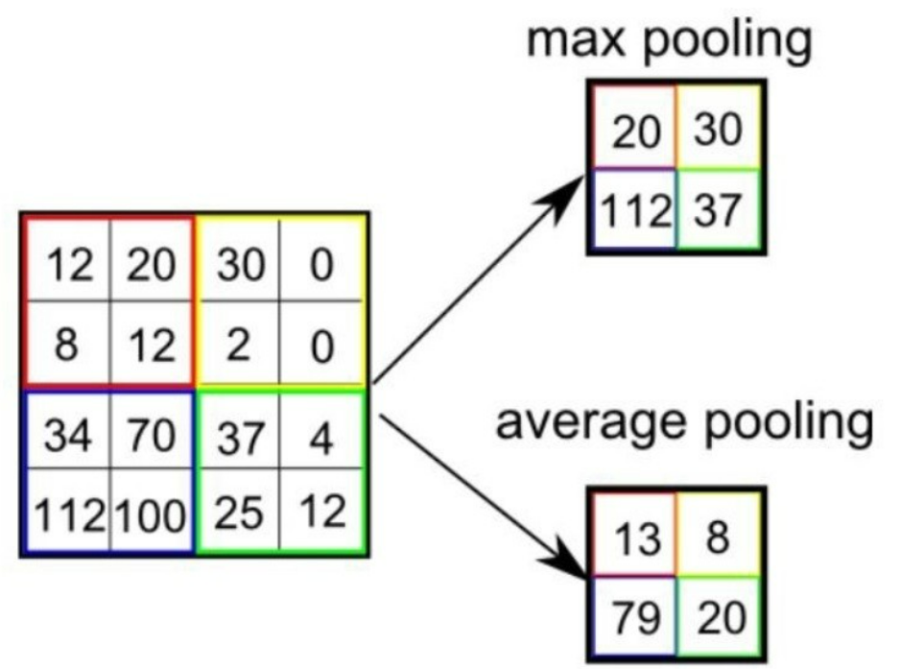
3. Pooling stage : choosing the maximum or average value that the filter is applied to create a new result
Classification stage : Compare features received from the previous stage and predict the result

Slide 21
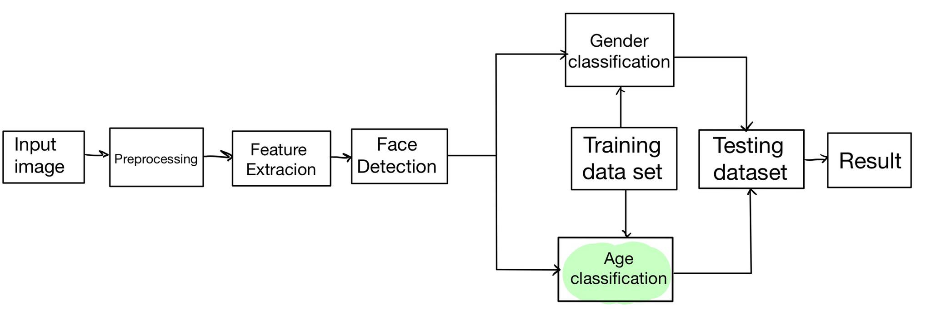
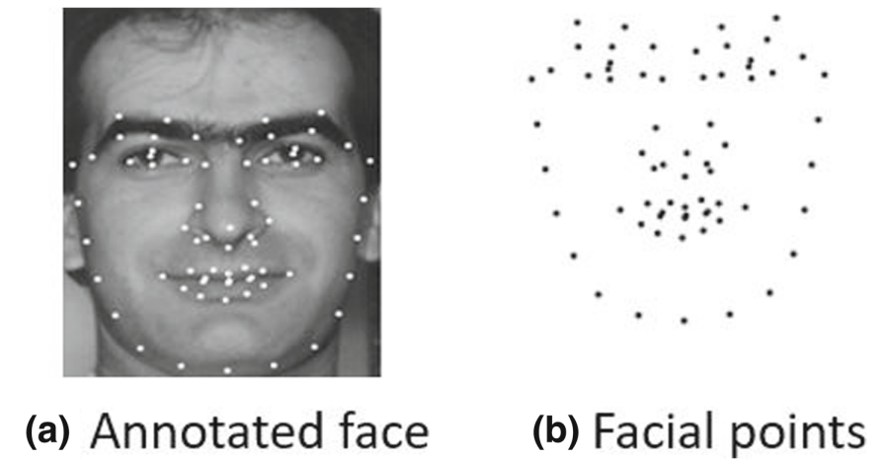
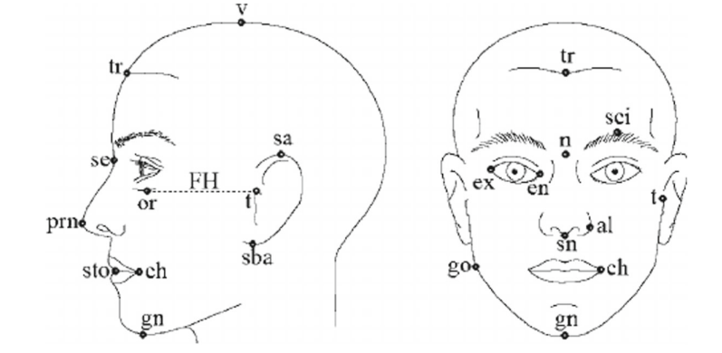
age Classification
Human on each age have a different face structure depend on the age range. We use various method such as Active appearance model, Active shape model, or even Anthropometric model to collect an information of the face and store it for feature extraction and classification.
Active appearance model
Anthropometric model
Ref:https://www.researchgate.net/publication/325613148_Age_estimation_via_face_images_a_survey

Slide 22
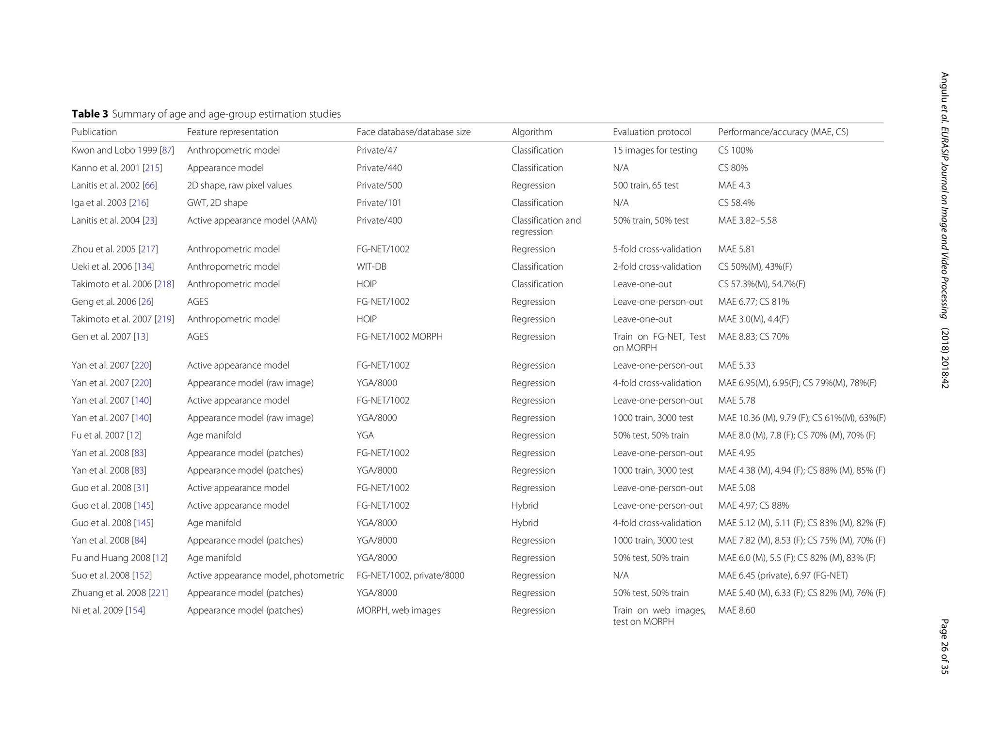
Performance
Ref:https://www.researchgate.net/publication/325613148_Age_estimation_via_face_images_a_survey

Slide 23
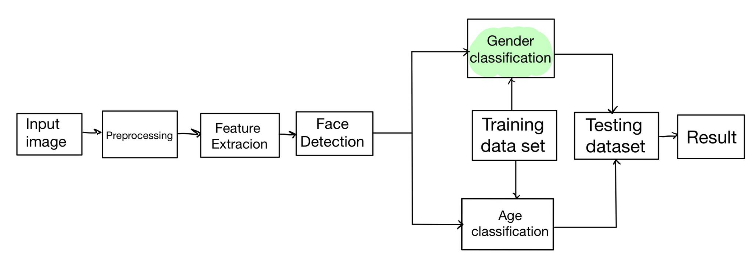
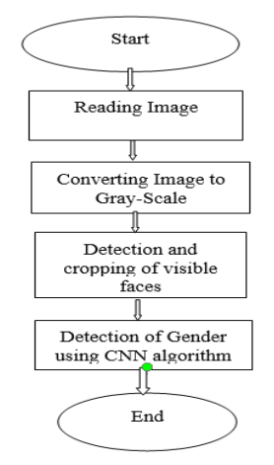
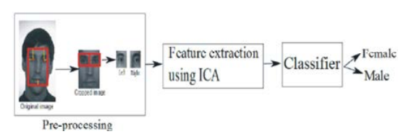
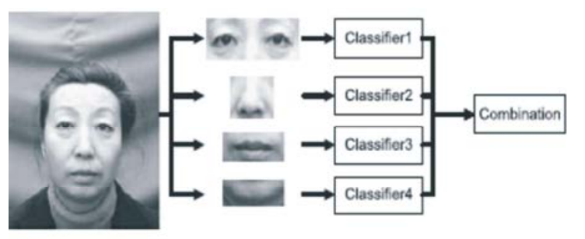
Gender prediction
Image classification into groups
Ref:https://www.irjet.net/archives/V9/i3/IRJET-V9I356.pdf
Ref:https://www.researchgate.net/publication/286707847_A_comparative_analysis_of_gender_classification_techniques?enrichId=rgreq-79f8cb6e4592badf1a0a9c8ed2b1c8de-XXX&enrichSource=Y292ZXJQYWdlOzI4NjcwNzg0NztBUzo3MjEwNjE1NjE3NzQwODFAMTU0ODkyNTg4MTAwOA%3D%3D&el=1_x_3&_esc=publicationCoverPdf

Slide 24
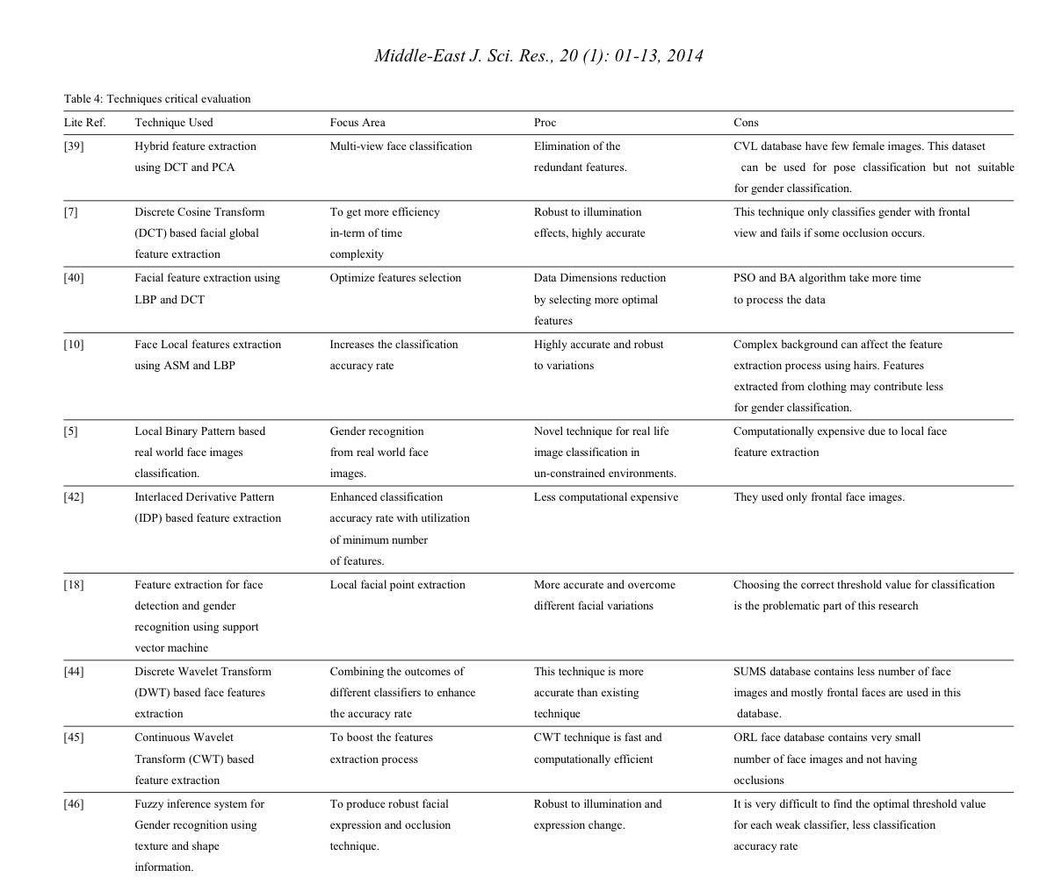
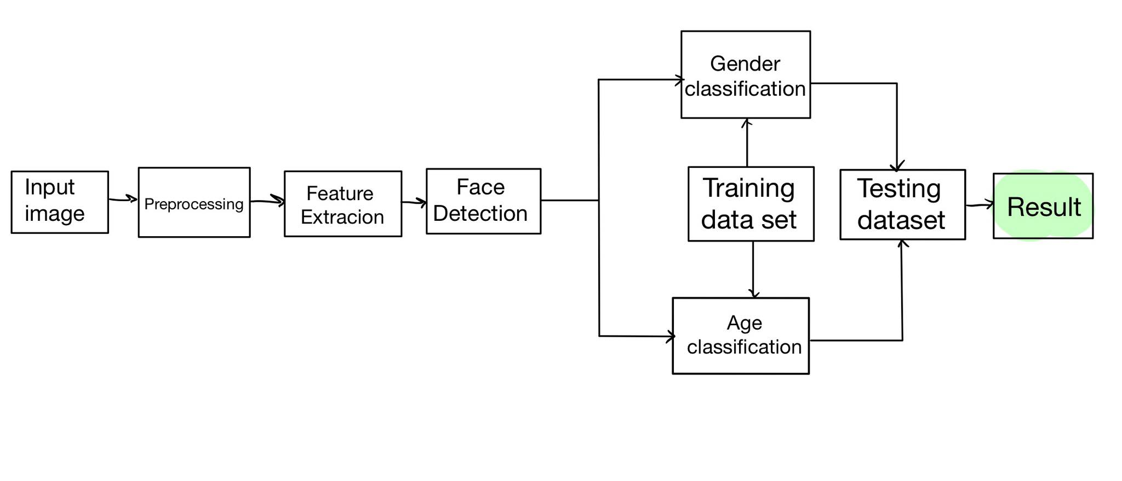
Performance

Slide 25
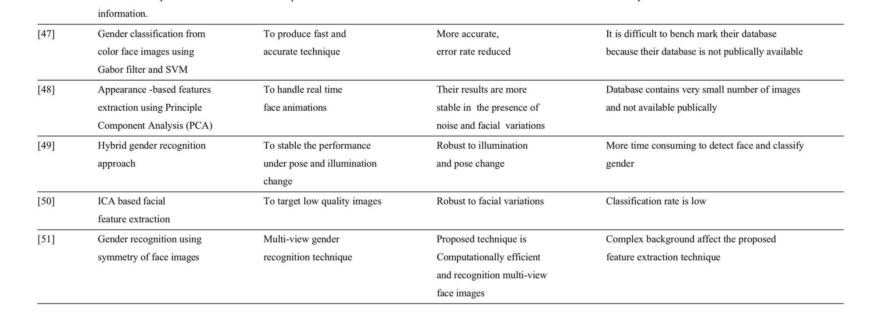
Performance

Slide 26
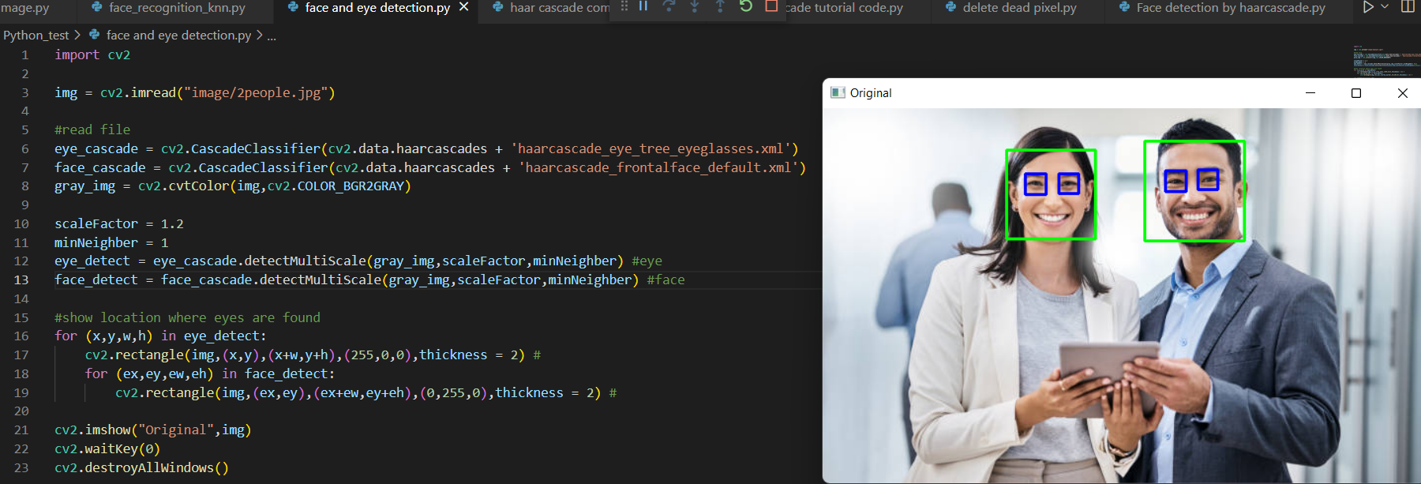
Some of The code I’ve studied from
Face and eye detection

Slide 27

Blurring Image

